Slide 1
Predicting Bank Marketing Response
E.J. Ogle

Slide 2
Direct Marketing in Banking
Direct: Universe of responders narrowed down to those most likely to purchase good/service, then marketed to
Distinctions along geo- and demographic lines, credit history info
Dimension reduction
Did customer purchase/respond in the end? Y/N

Slide 3
Data
Research set compiled by S. Moro, P. Cortez and P. Rita for “A Data-Driven Approach to Predict the Success of Bank Telemarketing” (2014)
May 2008 to Nov 2010
41,188 observations
20 attributes (original set contained 150
Unbalanced
 | Yes | No
Purchase (“y”) | 4640 | 36548

Slide 4
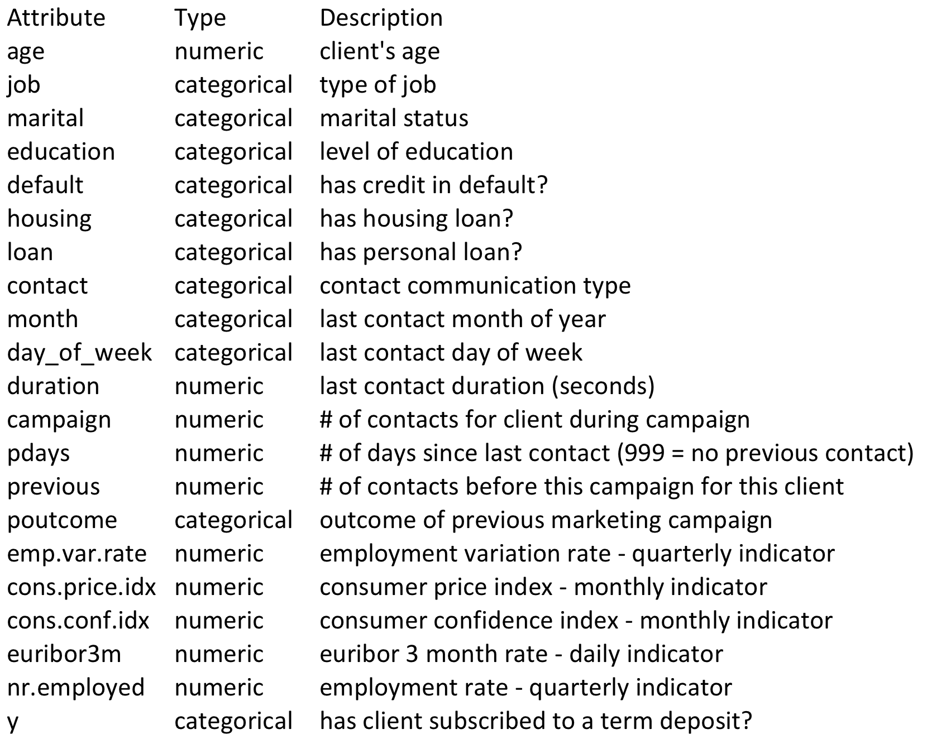
Data – Dictionary & Type

Slide 5
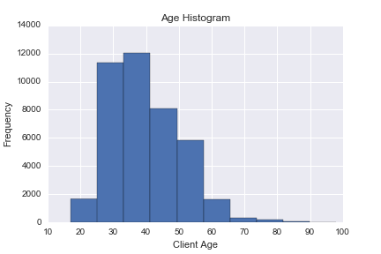
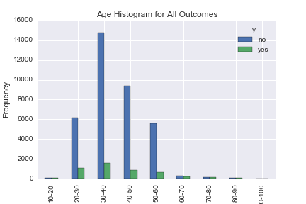
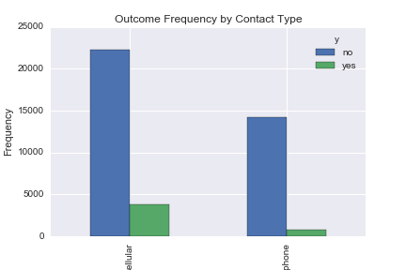

Slide 6
Sample population titled heavily towards administrative, blue-collar, and technician workers; additional analysis required for sampling methods, bias in responder demographics

Slide 7
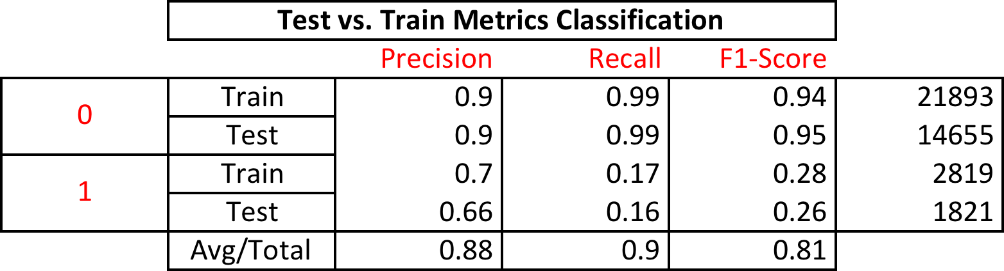
Logistic Regression Accuracy
Basic | Train | Test | CV (10)
89.80% | 89.73% | 89.82% | 82.32%
60/40 split between Train and Test

Slide 8
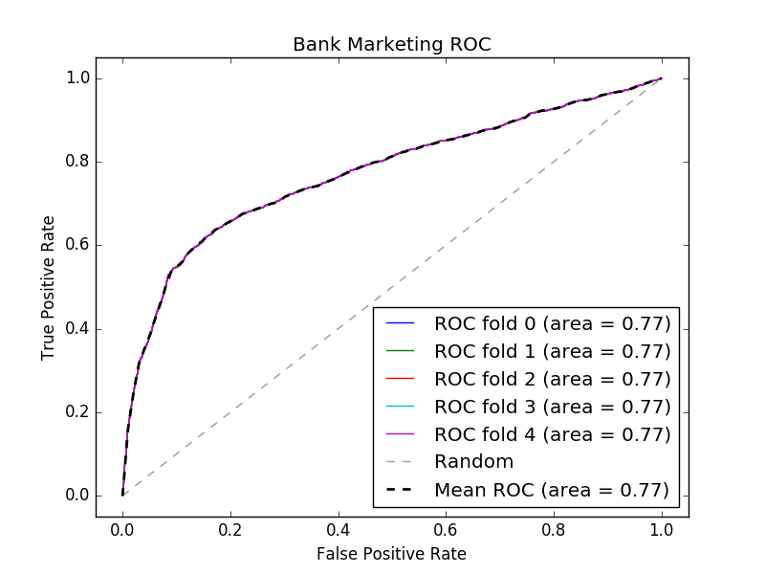
ROC, Cross Val with 5 folds
Notes:
Overall accuracy on unseen data is 77% (regardless of # of folds???) → could do better, explains why other researchers had better results with Neural Networks or Ross Quinlan new decision tree model (C5.0)

Slide 9
Confusion Matrices: With & Without Normalization

